Slide 1


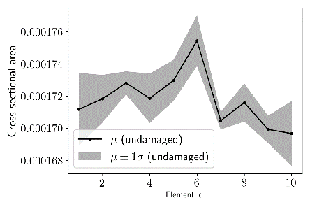
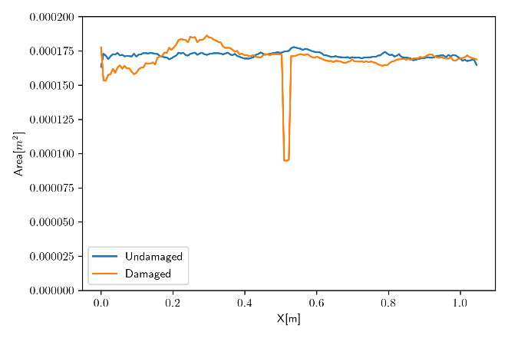
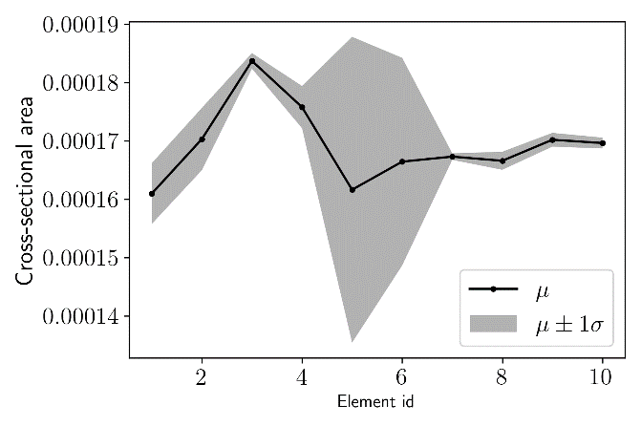
Title
Authors*
Affiliation
*Corresponding author Email：XXXX@XXX.com
TITLE
Introduction
Results and Discussion
Computer vision-based measurements are expected to supplement data needed for detailed and localized structural health monitoring by providing dense and accurate geometric information of target structures. Such approaches have been investigated frequently in the context of digital twin and scan-to-BIM. Existing software, such as Agisoft Metashape and RealityCapture, can be used first to convert collected images into dense and accurate 3D representations of the target structure. Several researches have been done for the post-processing of point cloud data and for general mesh post-processing purpose. Promising results from those research efforts increase the demand for the combined implementation of vibration-based and computer vision-based analysis to perform structural health monitoring that can be applied throughout the structure’s lifetime.
7. Computer vision-based model updating for undamaged beam
Element cross-sectional area and moments evaluated by this approach are shown in the left picutre below, where the mean and standard deviation of the values got from slices in each element are used as element-level values.
8. Model updating for damaged beam
Following the steps for the undamaged beam, cross-sectional properties of the damaged beam are estimated. The cross-sectional area evaluated for all slices are shown in the middle picture below. The cross-sectional area reduction is consistent with the reference value (47.6%) obtained by the manual measurement using a tape measure. The results reveal the capabilities of the computer vision-based measurement and data processing to detect, localize, and to some extent quantify structural damage represented by geometric change to the cross-sections. The mean and standard deviation of the cross-sectional area for the damaged beam are shown in the right picture below.
Compared to the undamaged case, the mean cross-sectional area decreased by 6.55% and 5.13% for element 5 and 6, respectively. Similarly, the mean values of Iy decreased by 7.11% and 10.47% for element 5 and 6, and the mean values of Iz decreased by 12.33% and 6.92% for those elements.
Objectives
This research investigates a framework for long-term structural health monitoring by computer vision and vibration-based model updating. The two sources of data, vibration data and computer vision data, are combined to supplement limitations of each of those measurement types; difficulty of estimating detailed and localized structural conditions (vibration-based approaches), and difficulty of estimating structural properties that cannot be observed visually (computer vision-based approach). As a platform for combining information from those heterogeneous sources, this research investigates a model-updating approach using FE model. Starting from an FE model with unknown (or inaccurate) geometric and material properties, the framework seeks to obtain the accurate representation of the structure by applying a sequence of two types of actions: (1) image collection, 3D reconstruction, and the extraction of localized geometric properties, and (2) vibration measurement and the extraction of global material properties through modal information. The first step, termed computer vision step, is based on the alignment of the approximate initial FE model to the 3D reconstruction, from which the geometric information associated with each element of the model is retrieved. The second step, termed vibration measurement step, performs system identification using vibration measurement data. Every time one of those actions is performed, the new information is merged into all the heterogeneous information obtained previously by the Bayesian model updating method. The recurrent application of those steps is expected to be a foundation for the efficient and reliable structural health monitoring of civil infrastructure throughout its lifetime.
Methodology
3. Computer vision-based survey and 3D reconstruction
After images of the target structure are collected with sufficient resolution and overlaps, a photogrammetry software called Agisoft Metashape is used to create dense point cloud data and the associated mesh models.
4. Computer vision-based updating: model alignment
The goal of this part is to align the reference FE model to the reconstructed model by estimating the 3D similarity transform between them. First, points of the reference model and the corresponding points of the aligned model are specified. After estimating and adjusting scale, those two sets of points are related by a rotation matrix, translation vector, and a noise vector. Using the calculated rotation matrix and translation vector, the point cloud is aligned to the reference FE model.
5. Computer vision-based updating: cross-section extraction
This research extracts localized cross-sectional information of beam elements by slicing the reconstructed mesh model along the “skeleton” that passes through centers of the cross-sections. The proposed approach initializes the skeleton by the aligned FE model, followed by the adjustment by fitting FE shape functions. The steps of adjusting initial skeleton curves are described as follows:
Step 1: Define the number of slices per element, where the cross sections are evaluated.
Step 2: For each element, slice the aligned reconstructed mesh at equally spaced points along the element centerline.
Step 3: Identify the centroid of the largest cross section on the sliced plane.
Step 4: Estimate linear combination coefficients of the continuous deformation in each element by least-square curve fitting.
The skeleton curves are derived from the FE model so that the resulting curves have clear correspondences to structural components with appropriate connectivity. Once the skeleton is identified, cross sectional areas and moments of inertia in two directions perpendicular to the beam axis are evaluated by slicing the reconstructed mesh model along the new skeleton.
Conclusion
This study discussed a framework for assessing and tracking structural conditions by combining computer vision-based 3D reconstruction and vibration measurement. The proposed approach first develops an initial FE model, and then updates the model by applying computer vision-based and vibration-based model updating sequentially. In the computer vision-based analysis, FE model is aligned to the reconstructed 3D model semi-automatically, based on which the element cross-sectional area and moments are identified by slicing the reconstructed model along the identified centerline (skeleton). The skeleton of the beam was initialized by the undeformed FE model, and then adjusted by fitting FE shape functions, allowing for robust skeleton detection and cross-section evaluation. The vibration-based analysis first performs operational modal analysis, and then applies Bayesian model updating method to correct element stiffness properties. Once local geometric damage is detected by the computer vision step, the effect to the structure is further evaluated by applying the vibration model updating to the damaged elements.
The proposed approach is validated using an experimental bamboo cantilever structure. First, the reference geometric and stiffness properties are identified by computer vision-based and vibration-based analyses for the undamaged structure. Then, the damage (local cross section reduction) was introduced to the cantilever beam, and additional round of computer vision-based and vibration-based measurements are performed. By analyzing the computer vision-based measurement data, the damage was detected and located accurately. Furthermore, the effect of the damage to the FE model is further evaluated by an additional round of vibration measurement and Bayesian model updating. The experimental investigation in this research demonstrates the basic capabilities of the proposed approach for developing a high-fidelity digital twin of civil infrastructure from heterogeneous measurement data.
Note: Institute logos and acknowledgements can be put here

